Slide 1
JavaScript Wizard Course for Beginners
By Seth
Codemal

Slide 2
Module 1: Introduction to JavaScript
What is JavaScript?
Brief history and evolution
Importance of JavaScript in web development
https://github.com/SethLK/JavaScript-Wizard-Course-for-Beginners

Slide 3
What is JavaScript?
Definition: A high-level, interpreted programming language that enables dynamic, interactive web pages.
Use Cases: Front-end web development, server-side development (Node.js), mobile app development, and more.
Comparison with HTML and CSS: Briefly explain the roles of HTML (structure) and CSS (styling) in conjunction with JavaScript.

Slide 4
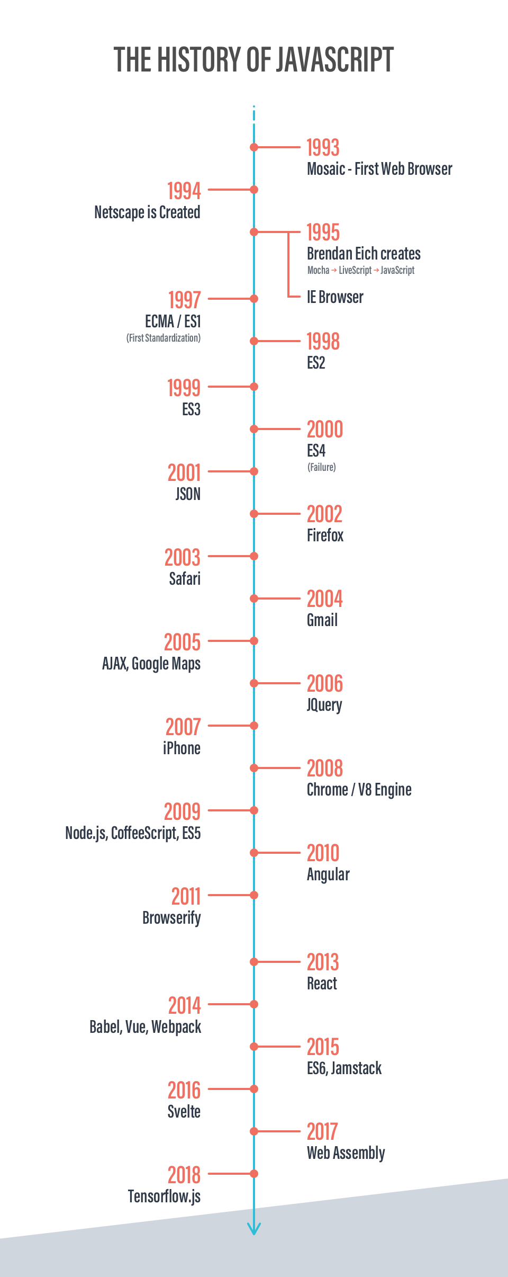
Section 2: Brief history and evolution
Origins: Developed by Netscape in 1995.
Evolution: Key versions and updates (ES5, ES6/ES2015,
etc.).
Popularity: Discuss JavaScript's widespread use and
the growth of frameworks and libraries.

Slide 5
Section 3: Importance of JavaScript in web development
Enhancing User Experience: Interactive features, dynamic content, and client-side validation.
Frameworks and Libraries: Mention popular ones like React, Angular, and Vue.
Full-Stack Development: JavaScript's role in both front-end and back-end development.

Slide 6
Module 2: Setting Up Your Development Environment
Text editors (e.g., Visual Studio Code)
Browser Developer Tools

Slide 7
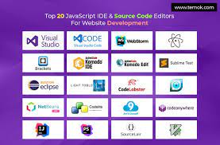
Section 1: Text Editors (5 mins)

Slide 8
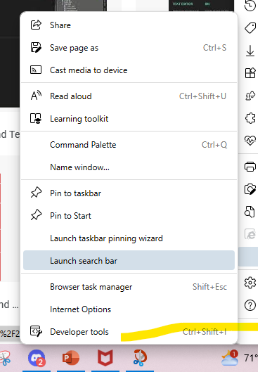
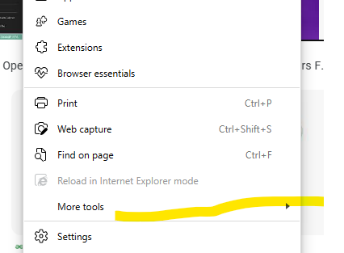
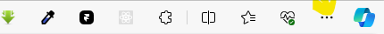
Section 2: Browser Developer Tools
Chrome, Ms edge, Firefox
Or Just Ctrl + Shift + i

Slide 9
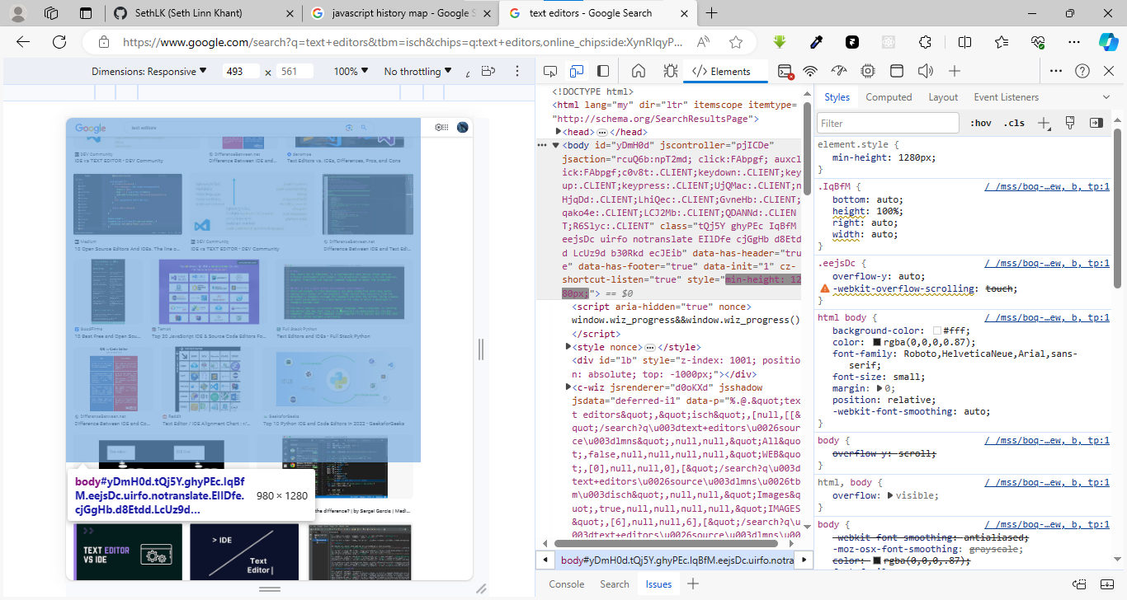
Section 2: Browser Developer Tools

Slide 10
Module 3: Basic JavaScript Syntax
Intro: Javascript (Js) in Html
Section 1: Variables and Data Types
Section 2: Operators
Section 3: Control Flow
Hands-on Exercise

Slide 11
Intro: Javascript (Js) in Html
3 ways to do js in html
Inline JavaScript:
Internal (or Embedded) JavaScript:
External JavaScript:

Slide 12
Intro: Javascript (Js) in Html
1st inline javascript
<!DOCTYPE html>
<html>
<head>
<title>Inline JavaScript Example</title>
</head>
<body>
<h1>Hello, World!</h1>
<script> alert("This is an inline JavaScript example"); </script>
</body>
</html>

Slide 13
Intro: Javascript (Js) in Html
1st inline javascript
<!DOCTYPE html>
<html>
<head>
<title>Inline JavaScript Example</title>
</head>
<body>
<h1>Hello, World!</h1>
<script src=“./script.js”> </script>
</body>
</html>

Slide 14
Intro: Javascript (Js) in Html
2nd Embedded javascript
<!DOCTYPE html>
<html>
<head>
<title>Inline JavaScript Example</title>
<script> alert("This is an inline JavaScript example"); </script>
</head>
<body>
<h1>Hello, World!</h1>
</body>
</html>

Slide 15
Intro: Javascript (Js) in Html
3rd External javascript
<!DOCTYPE html>
<html>
<head>
<title>Inline JavaScript Example</title>
</head>
<body>
<h1>Hello, World!</h1>
<script src=“./script.js”> </script>
</body>
</html>
Let element = document.getELementByTag(“h1”)
Element.innerText = “Hello There”

Slide 16
Section 1: Variables and Data Types
Variable Declaration: var, let, and const.
Var name = “codemal”
Const pi = 3.14;
Let me = “be your man”

Slide 17
Section 1: Variables and Data Types
Data Types
Cover primitive types (string, number, boolean)
“Code mal” String
1, 2.3, 345.34e Number
True false, 0 1 Boolean
Data Types
complex types (object, array).
const person = { //object
id: 1,
name: 'John Doe',
age: 25
};
Var array = [1,2,3,4] //array

Slide 18
Section 2: Operators
Arithmetic Operators: +, -, *, /, %
Comparison Operators: ==, ===, !=, !==, >, <, >=, <=
Logical Operators: &&, ||, !
Assignment Operators: =, +=, -=, *=, /=

Slide 19
DOM Manipulation
Definition: The Document Object Model (DOM) is a programming interface for web documents. DOM manipulation involves interacting with the HTML and XML documents dynamically using JavaScript.
Importance: Allows us to update, delete, or create HTML elements on the fly, responding to user interactions and making web pages interactive.

Slide 20
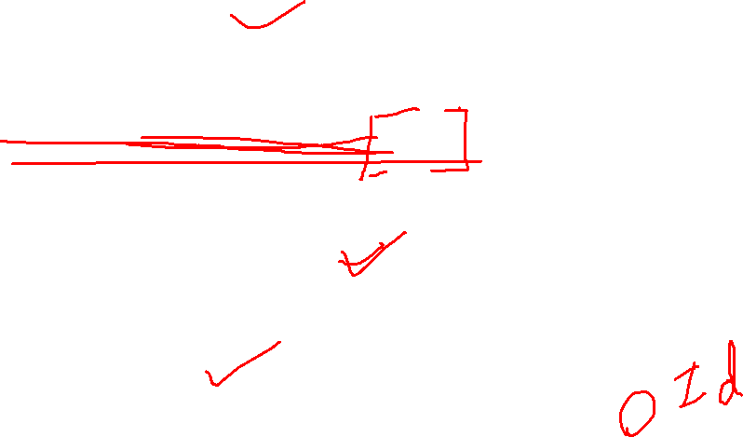
Selecting HTML Elements
getElementById:
const elementById = document.getElementById('myElementId’);
getElementsByClassName:
const elementsByClass = document.getElementsByClassName('myClass’);
getElementsByTagName:
const elementsByTag = document.getElementsByTagName('p’);
querySelector:
const element = document.querySelector('#myElementId');

Slide 21
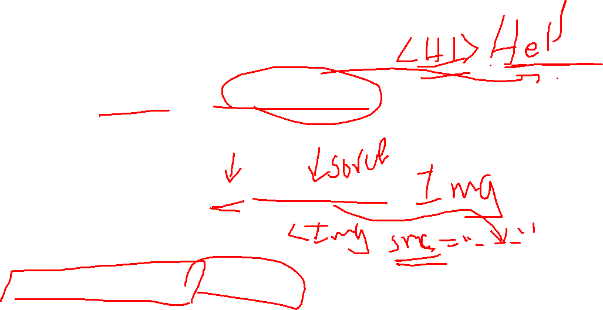
Manipulating HTML Elements
Changing Content:
element.innerHTML = 'New content’;
Changing Attributes:
element.setAttribute('src', 'newimage.jpg’);
Changing Styles:
element.style.color = 'blue';

Slide 22
Event Handling
Adding Event Listeners:
element.addEventListener('click', function() {
console.log('Element clicked!’);
});
Event Object:
element.addEventListener('mouseover', function(event) {
console.log(`Mouse coordinates: ${event.clientX}, ${event.clientY}`);
});

Slide 23
Creating and Appending Elements
Creating New Elements:
const newElement = document.createElement('div’);
Appending Elements:
parentElement.appendChild(newElement);

Slide 24
Modifying Classes
Adding and Removing Classes:
element.classList.add('newClass’);
element.classList.remove('oldClass');

Slide 25
Section 3: Control Flow
If Statements: Basic conditional statements.
Switch Statements: Introduction to switch-case.
Loops: for loops and while loops.

Slide 26
Section 3: Control Flow
If Statements: Basic conditional statements.
const age = 18;
if (age >= 18) {
console.log("You are eligible to vote."); // This block will be executed
} else {
console.log("Sorry, you are not eligible to vote.");
}

Slide 27
Section 3: Control Flow
Switch Statements: Introduction to switch-case.
const dayOfWeek = 3;
let dayName;
switch (dayOfWeek) {
case 1:
dayName = "Monday";
break;
case 2:
dayName = "Tuesday";
break;
case 3:
dayName = "Wednesday"; // This block will be executed
break;
case 4:
dayName = "Thursday";
break;
case 5:
dayName = "Friday";
break;
default:
dayName = "Weekend";
}
console.log(`Today is ${dayName}`);

Slide 28
Section 3: Control Flow
Loops: for loops and while loops.
For loop
// Example of a for loop to print numbers 1 to 5
for (let i = 1; i <= 5; i++) {
console.log(i);
}

Slide 29
Section 3: Control Flow
Loops: for loops and while loops.
While loop
// Example of a while loop to print numbers 1 to 5
let counter = 1;
while (counter <= 5) {
console.log(counter);
counter++;
}

Slide 30
Section 3: Control Flow
Loops: for loops and while loops.
Do While loop
// Example of a do while loop to print numbers 1 to 5
let counter = 1;
do {
console.log(counter);
counter++;
} while (counter <= 5)

Slide 31
Module 4: Functions and Scope
Introduction to Functions:
Function Expressions:
Parameters:
Return Values:
Scope:
Hoisting:

Slide 32
Introduction to Functions:
A function is a reusable block of code that performs a specific task or calculates a value. Functions help organize code, make it more modular, and allow you to avoid repetitive coding.
function functionName(parameters) {
// Function body: code to be executed
// Can include statements, expressions, and other code
return result; // Optional, used to return a value
}

Slide 33
Example
function greet() {
console.log("Hello, World!");
}
greet(); // Output: Hello, World!

Slide 34
Function Expressions:
Definition:
A function expression is another way to define a function, where the function is assigned to a variable. Function expressions can be anonymous (without a name) or named.
const functionName = function(parameters) { // Function body
return result;
};

Slide 35
Example
function greet = function() {
console.log("Hello, World!");
}// Invoking the function
greet(); // Output: Hello, World!

Slide 36
Parameters:
Definition:
Parameters are placeholders in a function definition that represent the values or variables passed to the function when it is invoked. They allow functions to receive input and work with different data.
function greet(name) {
console.log(`Hello, ${name}!`);
}
greet("John"); // Output: Hello, John!

Slide 37
Return Values:
Definition:
Return values are values that a function can send back to the code that called it. The return statement ends the execution of a function and specifies the value to be returned.
function add(a, b) {
return a + b;
}
const result = add(3, 5);
console.log(result); // Output: 8

Slide 38
Scope:
Definition:
Scope refers to the context in which variables are declared and can be accessed. JavaScript has two main types of scope: global scope (accessible throughout the entire program) and local scope (limited to a specific function or block).

Slide 39
Scope:
let globalVariable = "I'm global!";
function exampleFunction() {
let localVariable = "I'm local!";
console.log(globalVariable); // Accessible
}
console.log(localVariable); // Error: localVariable is not defined

Slide 40
Hoisting:
Definition:
Hoisting is a JavaScript behavior where variable and function declarations are moved to the top of their containing scope during the compilation phase. This allows you to use variables and functions before they are declared in the code.
console.log(example); // Output: undefined
var example = "hoisting example";
console.log(example); // Output: hoisting example

Slide 41
Module 5: Working with Arrays and Objects
Arrays:
creation,
manipulation,
iteration
Objects:
properties,
methods,
JSON

Slide 42
Arrays:
Definition:
An array is a data structure that stores a collection of elements. Each element in an array is identified by an index or a key. Arrays in JavaScript can hold different types of data, including numbers, strings, or other arrays.
let globalVariable = "I'm global!";function exampleFunction() { let localVariable = "I'm local!"; console.log(globalVariable); // Accessible}console.log(localVariable); // Error: localVariable is not defined

Slide 43
Arrays: Creation:
// Creating an empty array
const emptyArray = [];// Creating an array with elements
const numbers = [1, 2, 3, 4, 5];
const fruits = ['apple', 'banana', 'orange’];
// Creating an array with mixed data types
const mixedArray = [1, 'two', true, [4, 5], { key: 'value' }];

Slide 44
Arrays: Manipulation:
// Modifying elements
const numbers = [1, 2, 3, 4, 5];
numbers[2] = 10;
console.log(numbers); // Output: [1, 2, 10, 4, 5]
// Adding elements to the end
numbers.push(6);
console.log(numbers); // Output: [1, 2, 10, 4, 5, 6]

Slide 45
Arrays: Manipulation:
// Removing the last element
numbers.pop();
console.log(numbers); // Output: [1, 2, 10, 4, 5]
// Adding elements to the beginning
numbers.unshift(0);
console.log(numbers); // Output: [0, 1, 2, 10, 4, 5]

Slide 46
Arrays: Iteration:
// Using for loop
for (let i = 0; i < numbers.length; i++) {
console.log(numbers[i]);
}
// Using forEach method
numbers.forEach(function (element) {
console.log(element);
});// Using map method
const squaredNumbers = numbers.map(function (num) {
return num * num;});
console.log(squaredNumbers); // Output: [0, 1, 4, 100, 16, 25]

Slide 47
Objects:
Definition:
An object is a complex data type that allows you to store key-value pairs. It represents a collection of properties, where each property has a key and a corresponding value. Objects are versatile and can store various data types and even functions

Slide 48
Properties:
// Creating an object
const person = {
name: 'John’,
age: 25,
city: 'New York’
};// Accessing properties
console.log(person.name); // Output: John
console.log(person.age); // Output: 25// Modifying properties
person.age = 26;
console.log(person.age); // Output: 26

Slide 49
Methods:
// Adding a method to the object
const calculator = {
add: function (a, b) {
return a + b;
},
subtract: function (a, b) {
return a - b;
}
};
console.log(calculator.add(5, 3)); // Output: 8
console.log(calculator.subtract(8, 3)); // Output: 5

Slide 50
JSON (JavaScript Object Notation):
// Converting an object to JSON
const jsonPerson = JSON.stringify(person);
console.log(jsonPerson);
// Output: {"name":"John","age":26,"city":"New York"}// Parsing JSON back to an object
const parsedPerson = JSON.parse(jsonPerson);
console.log(parsedPerson);
// Output: { name: 'John', age: 26, city: 'New York' }

Slide 51
Class
What is a Class?
A class in JavaScript is a blueprint for creating objects. It serves as a template for defining the structure and behavior of objects. It encapsulates data (properties) and methods (functions) that operate on that data.
Classes were introduced in ECMAScript 2015 (ES6).
Before ES6, JavaScript used prototype-based inheritance rather than classical inheritance found in languages like Java or C++. Prototypal inheritance can be less intuitive and verbose for those coming from classical inheritance backgrounds.
Classes in ES6 provide a more familiar syntax for defining object-oriented programming (OOP) constructs like constructors, methods, and inheritance, similar to other object-oriented programming languages.

Slide 52
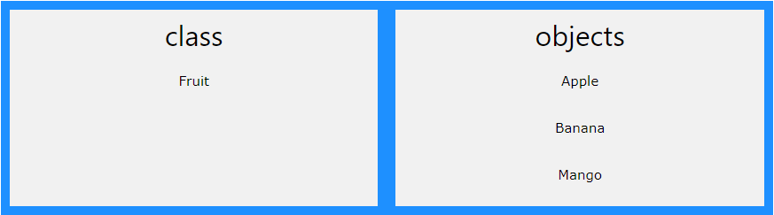
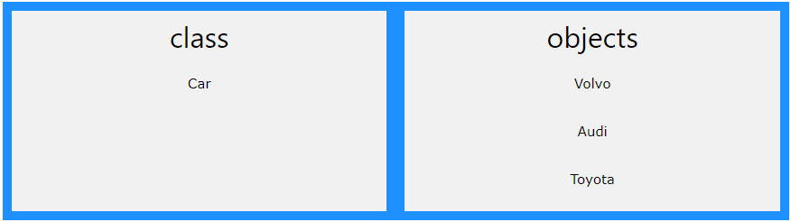
What are Classes and Objects?

Slide 53
class ClassName {
constructor(/* parameters */) {
// Constructor: Initializes object properties
} // Methods: Define methods to operate on object data
}

Slide 54
Example:
Let's create a simple class representing a car:
class Car {
constructor(brand, model, year) {
this.brand = brand;
this.model = model;
this.year = year;
} // Method to display car information
displayInfo() {
console.log(`Brand: ${this.brand},
Model: ${this.model},
Year: ${this.year}`);
}
}

Slide 55
Creating an instance of the Car class
const myCar = new Car('Toyota', 'Corolla', 2022);// Calling a method on
the instance
myCar.displayInfo(); // Output: Brand: Toyota, Model: Corolla, Year:
2022

Slide 56
Key Concepts:
Constructor:
A special method called when an instance of the class is created. It is used for initializing object properties.
Methods: Functions defined within the class that operate on object data.
Properties: Data associated with objects, accessed using dot notation (this.propertyName).
Instantiation: The process of creating an instance (object) of a class using the new keyword.

Slide 57
Inheritance:
Classes in JavaScript support inheritance, allowing you to create subclasses that inherit properties and methods from a parent class. This is achieved using the extends keyword.

Slide 58
Example of Inheritance:
class ElectricCar extends Car {
constructor(brand, model, year, batteryCapacity) {
super(brand, model, year); // Calls the constructor of the parent class
this.batteryCapacity = batteryCapacity;
} // Additional method specific to ElectricCar
displayBatteryCapacity() {
console.log(`Battery Capacity: ${this.batteryCapacity}`);
}
}// Creating an instance of Car

Slide 59
Example of Inheritance:
const myElectricCar = new ElectricCar('Tesla', 'Model S', 2022, '100
kWh’);
// Calling methods from both parent and subclass
myElectricCar.displayInfo(); // Output: Brand: Tesla, Model: Model S, Year:
2022
myElectricCar.displayBatteryCapacity(); // Output: Battery Capacity: 100 kWh

Slide 60
Asynchronous

Slide 61
Callback Functions in JavaScript
In JavaScript, a callback function is a function that is passed as an argument to another function and is executed after some operation or event has occurred. Callbacks are commonly used in asynchronous programming to handle tasks that take time to complete, such as fetching data from a server, reading files, or responding to user interactions.

Slide 62
Example of a Callback Function:
// Function that takes a callback as an argument and invokes it
function doSomethingAsync(callback) {
setTimeout(() => {
// Simulate an asynchronous operation
const result = 'Data retrieved successfully’;
callback(result);
}, 2000); // Simulate a delay of 2 seconds
}// Callback function to handle the result
function handleResult(result) {
console.log(result);
}// Using the function with a callback
doSomethingAsync(handleResult);

Slide 63
Benefits of Callbacks:
Asynchronous Programming: Callbacks enable asynchronous programming in JavaScript, allowing operations to continue while waiting for asynchronous tasks to complete.
Flexibility: Callbacks provide a flexible way to define behavior that should occur after an operation or event has completed. This makes it easy to customize functionality based on different scenarios.
Modularity: Callbacks promote modularity by allowing you to separate concerns and encapsulate functionality within individual functions.

Slide 64
Promises in JavaScript
Introduction to Promises:
Promises in JavaScript provide a cleaner and more intuitive way to handle asynchronous operations. They represent a value that may be available now, or in the future, or never. Promises have three states: pending, fulfilled (resolved), and rejected.

Slide 65
Creating a Promise:
const myPromise = new Promise((resolve, reject) => {
// Asynchronous operation
setTimeout(() => {
// Simulate a successful operation
const data = 'Operation completed successfully’;
resolve(data); // Fulfill the promise with data
// If unsuccessful:
reject(error);
}, 2000); // Simulate a delay of 2 seconds
});

Slide 66
Consuming a Promise:
myPromise.then((data) => {
console.log(data); // Output: Operation completed successfully
}).catch((error) => {
console.error(error);
// Output: Any errors that occurred during the operation
});

Slide 67
Chaining Promises:
myPromise
.then((data) => {
console.log(data); // Output: Operation completed successfully
return 'Additional data’;
})
.then((additionalData) => {
console.log(additionalData); // Output: Additional data
})
.catch((error) => {
console.error(error);
// Output: Any errors that occurred during the operation
});

Slide 68
Data fetching
1. Fetch API:
The Fetch API is a modern, promise-based API for making network requests in JavaScript. It provides a cleaner syntax and better error handling compared to XMLHttpRequest. Here's how you can use Fetch to fetch data:
2. XMLHttpRequest (XHR):
XMLHttpRequest is an older method for making network requests in JavaScript. It has been around for a long time and is widely supported by browsers. Here's how you can use XMLHttpRequest to fetch data:

Slide 69
Data fetching
3. Axios (Library):
Axios is a popular promise-based HTTP client for the browser and Node.js. It provides an easy-to-use API and supports features like request and response interception, global error handling, and more. Here's how you can use Axios to fetch data:

Slide 70
Fetch API:
fetch('https://api.example.com/data’)
.then(response => {
if (!response.ok) {
throw new Error('Network response was not ok’);
}
return response.json();
})
.then(data => {
console.log(data);
})
.catch(error => {
console.error('There was a problem with the fetch operation:', error);
});

Slide 71
XMLHttpRequest (XHR):
var xhttp = new XMLHttpRequest();
xhttp.onreadystatechange = function() {
if (this.readyState == 4 && this.status == 200) {
var data = JSON.parse(this.responseText);
console.log(data); }};
xhttp.open('GET', 'https://api.example.com/data', true);
xhttp.send();

Slide 72
Axios (Library):
axios.get('https://api.example.com/data’)
.then(response => {
console.log(response.data);
})
.catch(error => {
console.error('There was a problem with the request:', error);
});

Slide 73
Async/Await
Async/await is a modern JavaScript feature introduced in ES8 (ECMAScript 2017) that provides a cleaner syntax for working with asynchronous code. It allows you to write asynchronous code that looks and behaves like synchronous code, making it easier to understand and maintain. Async/await is built on top of promises and is widely supported in modern browsers and Node.js environments.

Slide 74
Async Functions:
An async function is a function that returns a promise. Inside an async function, you can use the await keyword to pause the execution of code until a promise is resolved or rejected. Here's how you can define an async function:

Slide 75
Async Functions:
async function fetchData() {
try {
const response = await fetch('https://api.example.com/data’);
const data = await response.json();
return data;
} catch (error) {
console.error('Error fetching data:', error);
throw error;
}
}

Slide 76
Using Async/Await:
You can call an async function using the await keyword, which waits for the promise returned by the async function to be resolved. Here's how you can use async/await to fetch data:

Slide 77
Using Async/Await:
async function processData() {
try {
const data = await fetchData();
console.log(data);
} catch (error) {
console.error('Error processing data:', error);
}
}
processData();

